Slide 1
Coder / De-Coder – Jan 8
Agenda
Module B.7 Coder / De-Coder
Level 1 – Sample Program
Level 2 – ASCII Code
Level 3 – Your Secret Code
Upcoming
January Schedule

Slide 2
January Calendar
Date | ICS20
Mon Jan 7 | Heroes Trade Show
Tue Jan 8 | Mod B.7 Python Coder / De-Coder
Wed Jan 9 | Mod B.7 Python Coder / De-Coder
Thu Jan 10 | Mod B.7 Python Coder / De-Coder
Fri Jan 11 | Mod B.7 Python Coder / De-Coder
Mon Jan 14
Tue Jan 15
Wed Jan 16
Thu Jan 17
Fri Jan 18 | Prep for Summative - Review
Mon Jan 21 | Summative Part 1 – Computer Concepts
Tue Jan 22 | Summative Part 2 – Programming
Wed Jan 23 | Summative Part 2 – Computers & Society

Slide 3
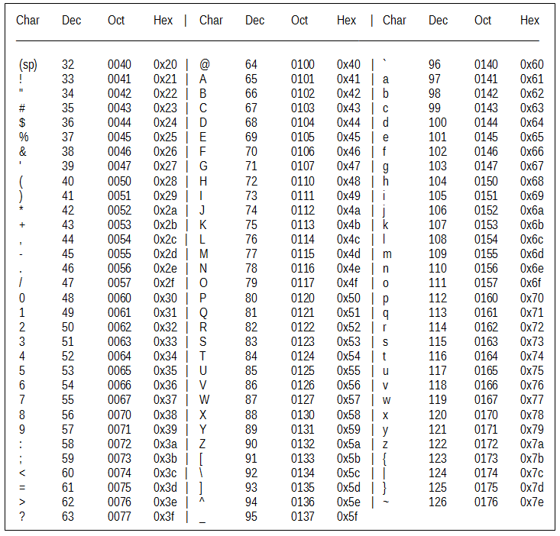
Decode This Message
73 32 104 111
112 101 32 121
111 117 32 119
105 108 108 32
101 110 106 111
121 32 111 117
114 32 110 101
120 116 32 97
115 115 105 103
110 109 101 110
116 33

Slide 4
Decode This Message
73 32 104 111
112 101 32 121
111 117 32 119
105 108 108 32
101 110 106 111
121 32 111 117
114 32 110 101
120 116 32 97
115 115 105 103
110 109 101 110
116 33

